Slide 1
CREATING A TECHNICAL INFRA-STRUCTURE FOR REPORTING OBLIGATIONS
SCM September 2013 Finland Meeting

Slide 2
Once only submitting principle
Ensuring that the businesses need to supply information only once because the Public Agencies share this data.

Slide 3
Easy to submit principle
And it should also be easy to submit information about the business to the agencies.

Slide 4
The Aim
The Swedish Government wants to create a positive noticeable change in day – to – day conditions for businesses.
The Goal
In 2020 business will in most cases only need to submit information once and to one place.

Slide 5
Two main components
1. Mapping reporting obligations
14 agencies.
2 years.
9,4 million SEK.
Inquiry Committee
One and a half year.
Technical infrastructure.
Legal aspects.
Coordination of infrastructure on reporting obligation.

Slide 6
Mapping reporting obligation
Standard cost model.
4 600 information obligation in the database Malin.
Reporting obligations.
1 164 reporting obligation.
94 558 36 times a year.

Slide 7
Authorithies | Reporting obligation, number | Reporting obligation, volym
Public Employment | 21 | 1 787 755
Company Registration | 124 | 847 663
Social Insurance Agency | 35 | 11 704 032
Board of Agriculture | 388 | 2 774 023
Enforcement Authority | 6 | 1 605 515
National Food Agency | 62 | 4 846
Statistics Sweden | 59 | 799 650
Tax Agency | 102 | 68 998 019
Forest Agency | 31 | 76 108
Agency for Growth | 23 | 49 129
Transport Analysis | 5 | 13 125
Transport Administration | 23 | 163 703
Transports Agency | 209 | 180 665
Custom | 76 | 5 554 136
Total | 1164 | 94 558 36

Slide 8
Basic reporting obligations
38 basic reporting obligations.
Name, registration number, phone number, address etc.
Savings approx. 2,25 billion SEK on a yearly basis (1 million companies, 90 forms, time 3 minutes, cost per hour 500 SEK).

Slide 9
Inquiray Committee
Cecilia Magnusson Sjöberg, Professor of Law and Information Technology, Director of the Swedish Law & Informatics Research Institute.
15 experts from Ministries and Agencies and the Board of Swedish Industry and Commerce for Better Regulation (NNR).

Slide 10
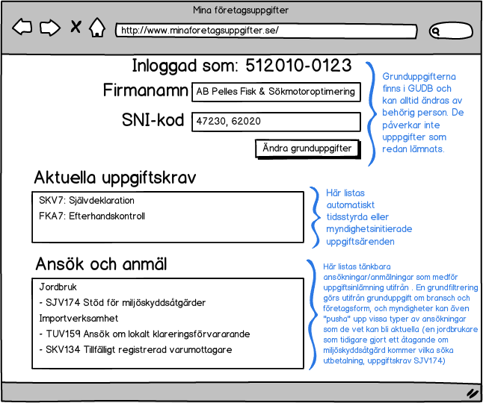
An E- service

Slide 11
OBLIGATION
Definitions
OBLIGATION
Demands
KOORDINATED Obligations
SUBMISSIONS
GENERELL OBLIGATIONS
SPECIFIC OBLIGATIONS RELATING TO A BUSINESS/BRANSCH etc
THE REGISTER

Slide 12
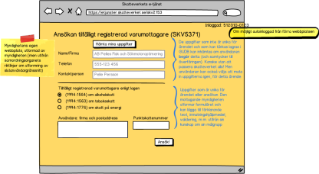
KOORDINATED Obligations
SUBMISSIONS
OBLIGATION
Definitions
OBLIGATION
Demands
SKVDB
THE REGISTER

Slide 13
Thank you for your attention!
Elisabeth Kristensson
Deputy Director
elisabeth.kristensson@gov.se

